Slide 1


Department of Computer Science and Engineering
GE19621 PROFESSIONAL READINESS FOR
INNOVATION, EMPLOYABILITY AND
ENREPRENEURSHIP
HEALTHCARE CENTER PERFORMANCE ANALYZER
Bhuvanesh C S
210701042
Easwaran T 210701058
Dr.T.Kumaragurubaran., M.Tech., Ph.D AP(SG).,
Professor

Slide 2
Abstract
Healthcare is vital, and minimizing human error in patient care is crucial. To address this, we're developing a web-based analysis application to compare patients' preoperative and post-operative data, predicting the effectiveness of hospital decisions. This smart tool will help hospitals utilize their data better, guiding doctors and staff to improve patient care. By providing accurate predictions on surgery outcomes based on surgeon experience and patient test data, the tool aids in making informed decisions. This innovation aims to enhance healthcare efficiency and safety, ensuring better decision-making and improved patient outcomes. Ultimately, it helps hospitals identify safe and effective treatment methods, leading to higher standards of care.

Slide 3
Existing System
The existing healthcare system struggles with managing complex, large volumes of patient data and making timely, accurate decisions. Manual processes often lead to errors and incorrect insights. Data from various sources, like diagnostic tests and medical records, are stored in silos, complicating analysis. This hampers professionals' ability to recognize patterns and trends. The lack of interaction between systems causes delays in accessing relevant patient data, impacting timely treatment. Without robust data analytics, decisions rely heavily on judgment, which doesn't always account for complexities. Manual reviews are prone to errors, risking patient safety and reducing treatment efficiency. This segmented data management and limited analytical capability underscore the need for innovative solutions to streamline data integration, enhance analytics, and support better decision-making across care centers.

Slide 4
Proposed System
The proposed system revolutionizes healthcare delivery by leveraging technology for better patient care management. It addresses current challenges with a comprehensive, data-driven approach. A web-based analysis application uses predictive analytics on extensive datasets, providing valuable insights into patient status, outcomes, and risks. Key features include real-time monitoring for timely decisions, advanced machine learning algorithms to predict outcomes, and seamless data exchange with existing health records. This integration enhances data sharing and collaboration among care teams. Additionally, it streamlines administrative procedures, enabling data-driven decisions to improve efficiency and resource utilization, ultimately empowering healthcare professionals with informed decision-making.

Slide 5
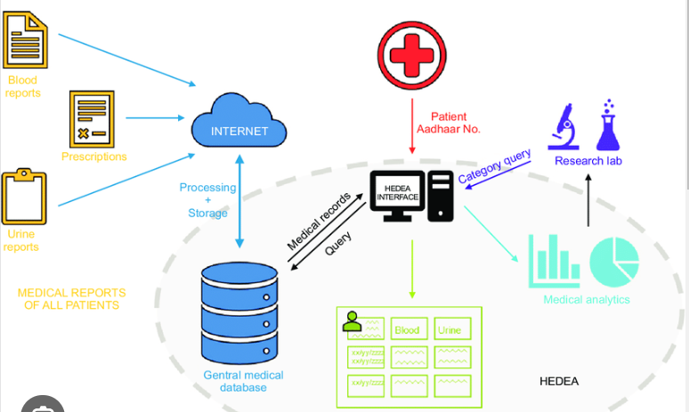
System Architecture

Slide 6
List of Modules
Creation of Dataset
Creating Prediction and Analysis Machine Learning model
Connecting with the Server
Testing

Slide 7
Functional Description for each modules
Creation of Dataset: Creating healthcare dataset involves defining objectives, collecting data from various sources, cleaning it by removing duplicates and handling missing values, and standardizing formats. The data is then integrated and transformed, ensuring consistency. Finally, feature engineering is performed to create new, useful variables for analysis and predictive modeling.

Slide 8
Functional Description of Module
Creating Prediction and Analysis Machine Learning model: After creating the healthcare database through the dataset it is important to create model for prediction and analysis. The analysis model was created for different parameters like blood group, bmp and so on. Also the prediction for the healthcare success rate was also produced and analyzed very carefully. Hence by this way creating prediction and analysis was done

Slide 9
Functional Description of Module
Connecting with Servers: As we are planning it as a system based working application it temporarily needs a server to run and do the prediction and analysis. So once the server is started it will automatically connects with the model and database.Connecting to a server involves establishing a secure connection using protocols like SSH for remote access. Ensure proper authentication using credentials or keys. Once connected, you can interact with the server's resources and manage files, databases, and applications remotely. To connect with a server, use tools like SSH or VPN for secure access.

Slide 10
Functional Description of Module
Testing: The healthcare center performance analyzer project aims to assess and improve operational efficiency and patient care outcomes. By analyzing various metrics such as patient wait times, treatment success rates, and staff productivity, the system provides insights into the healthcare center's performance. Through statistical analysis and visualization tools, it identifies trends, bottlenecks, and areas for improvement. Real-time monitoring capabilities enable timely interventions and adjustments to enhance overall healthcare service delivery.

Slide 11
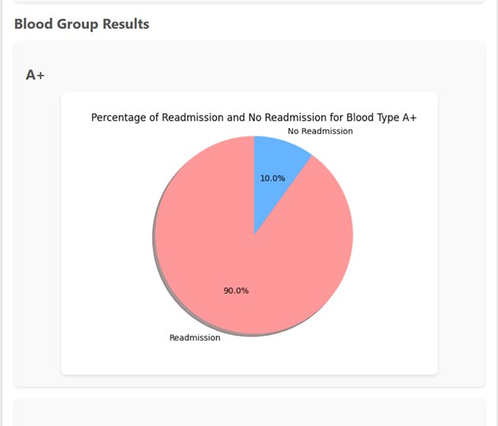
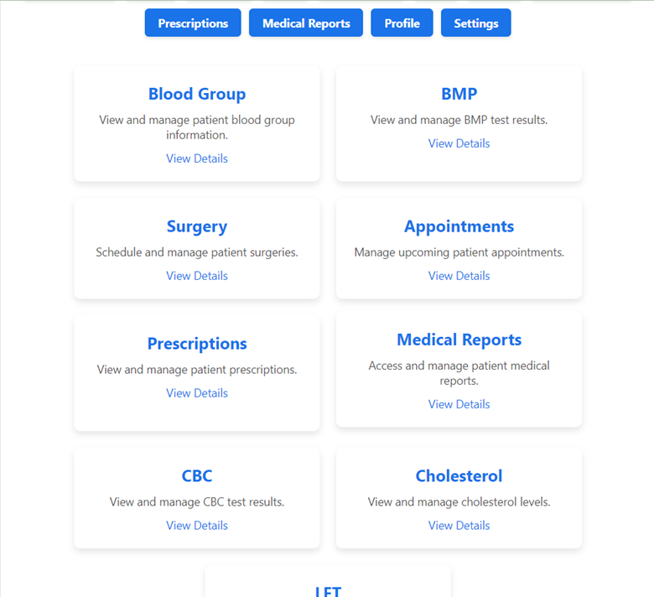
Output
Initial page of the application
Pie chart Analysis of readmission based on blood type

Slide 12
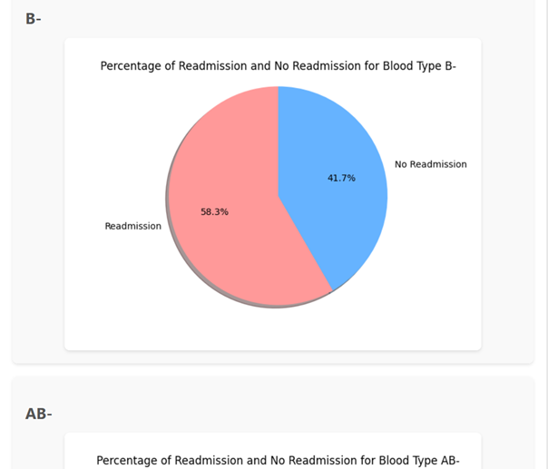
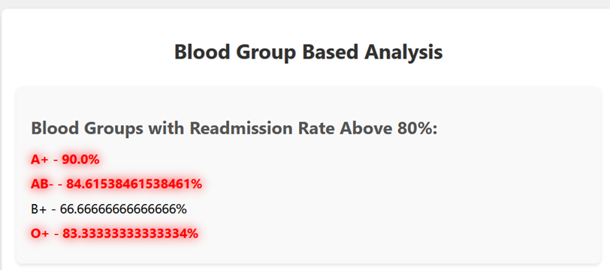
Output
Summary stating the highest percent of readmission
Analysis of different blood group

Slide 13
Conclusion
In conclusion, the project represents a significant step forward in leveraging data analytics to address critical issues in healthcare, particularly concerning patient readmission rates. By focusing on blood group data as a primary parameter, the platform provides healthcare practitioners with valuable insights into factors influencing patient outcomes. Through intuitive visualizations and robust analytics, users can quickly identify trends and patterns, enabling proactive interventions to improve patient care quality and reduce readmission rates. The user experience is designed with usability and efficiency in mind, ensuring that healthcare professionals can easily navigate the platform and derive actionable insights from the data presented.

Slide 14
References
1. Flask Framework for Python Developer (Book)
2. Data Analytics Using Python (Book)
3. Data Visualization Using Python (Book)
4. https://www.ncbi.nlm.nih.gov/
5. https://www.safetyandquality.gov.au/
6. https://www.covetus.com/blog/
7. https://www.nhsinform.scot/campaigns/health-and-social-care-standards/
8. https://analytics.google.com/analytics/academy/

Slide 15
Thank You

